Slide 1
Treasure Island
Edtech companies are playing an important role in Education. Their objective is to improve students performance regarding different subjects. Most of them relying in online games (gamification) as an strategy to help students to engage in different subjects and therefore improve their grades.
The context of this project is a dataset that contain a universe of students in where among other features, a mailing was sent containing a treasure island map that students could use to play an online mission to earn extra coins.
The objective of the mailing was to test whether or not inactive users could be incentivized to start playing again.

Slide 2
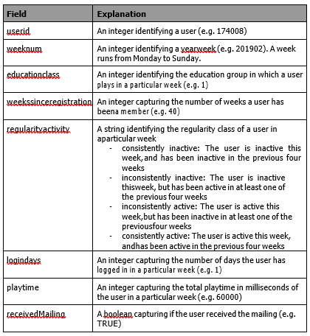
Treasure island dataset contains variables that are meant to analyze the impact of the mailing. As follow the content of the dataset:

Slide 3
There are two questions that have arisen given this scenario:
Has the mailing been successful in reactivating consistently inactive users?
If so, how long has this impact been sustained (i.e. how many weeks)?

Slide 4
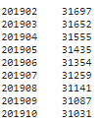
Approach
This is an impact evaluation study. We may want to see the effect of the mailing strategy over consistenly inactive users
First variable to take into account is if the user received a mailing or not (receivedMailing). So that is going to help us to split the data in a Control and Experimental Group (if they got the mail they belong to experimental group, otherwise they are Control).
Second variable to consider is the week number (weeknum). The mailing was sent on 201903 week and our data set contain the following weeks:

Slide 5
The week number is going to determine a pre and post scenario (before and after receiving the mailing) and it will help us to see the effect of the mailing in the users. Weeknum < 201903 and weeknum >= 201903, will determine pre and post scenarios, respectively.
Our case will end up with 6 (six) different subsets:
Pre_data_control (they did not get the mailing and they belong to weeknum < 201903)
Post_data_control (they did not get the mailing and they belong to weeknum >= 201903)
Pre_data_experimental (they got the mailing and they belong to weeknum < 201903)
Post_data_experimental (they got the mailing and they belong to weeknum >= 201903)
First_week_control (they did not get the mailing and they belong to 201903 week only)
First week experimental (they got the mailing and they belong to 201903 week only).

Slide 6
The week number is going to determine a pre and post scenario (before and after receiving the mailing) and it will help us to see the effect of the mailing in the users. Weeknum < 201903 and weeknum >= 201903, will determine pre and post scenarios, respectively.
Our case will end up with 6 (six) different subsets:
Pre_data_control (they did not get the mailing and they belong to weeknum < 201903)
Post_data_control (they did not get the mailing and they belong to weeknum >= 201903)
Pre_data_experimental (they got the mailing and they belong to weeknum < 201903)
Post_data_experimental (they got the mailing and they belong to weeknum >= 201903)
First_week_control (they did not get the mailing and they belong to 201903 week only)
First week experimental (they got the mailing and they belong to 201903 week only).

Slide 7
Since we want to see the effect of the mailing over consistently inactive users, we need to spot how many of those are out of the three categories from regularityactivity feature.
Pre_inactive_control users are retrieved out of the Pre data control group
Pre_inactive_experimental are retrieved out of the Pre_data_experimental
First week inactive control are retrieved out of the First week control group
First week inactive experimental are retrieved out of the First week experimental.
These pre-processing of data is needed in order to respond 1st research question:
Has the mailing been successful in reactivating consistently inactive users?

Slide 8
We need to check if there has been any impact from the week prior the intervention (weeknum <201903) and the first week after sending the mail (for the control and experimental group)
Difference between pre-week control group vs. first week group
Difference between pre-week experimental group vs. first week group
For that, we need to build up three matrices:
First_week_matrix, which compares first inactive control group vs first inactive experimental group
Experimental group matrix which compares pre inactive experimental group vs first inactive experimental grpup.
We also want to see if there are differences in the control group, for that, we create a control matrix that compares pre inactive control user’s vs first week inactive control
The statistical technique suggested to determine whether there are differences or not between the different groups is Proportion Z Test.

Slide 9
RQ1: Has the mailing been successful in reactivating consistently inactive users?
RESULTS BEFORE AND AFTER RECEIVING THE MAILING

Slide 10
Control
We may want to see if there are differences in terms of proportions of consistently inactive users before and after weeknum 201903. Even though this is control group, which means that they havent received mailing, its worth to determine if groups change their status before and after 201903 week.
For doing so, we ran a Prop Z Test, so we can determine if groups are significally different or not in pre and post control scenarios.
The p-value is .41 which is more than the significance level of 0.05. We can conclude that the proportion of
Consistenly inactive users is not significally different on a pre mailing and post mailing situation in the control group.

Slide 11
Experimental
We may want to see if there are differences in terms of proportions of consistently inactive users before and after weeknum 201903. This is the experimental group which means that they have received mailing (input) that may explain a change in their behaviour after receiving mailing.
For doing so, we ran a Prop Z Test, so we can determine if groups are different or not in pre and post experimental scenarios.
The p-value is 5.192 e-12 which is less than the significance level of 0.05. We can conclude that the proportions of
Consistenly inactive users are different in the experimental setting.

Slide 12
Control vs. Experimental

Slide 13
RESULTS FOR THE WEEK 201903 SOLELY (WEEK OF RECEIVING THE MAILING)

Slide 14
201903 Week - Control vs. Experimental
By comparing just the week 201903 in a group that hasn’t received any mailing and the group that
received mailing in the 201903 week, we might see if there is a difference in terms of consistently inactive
Users between the two groups or not. For knowing so, we ran a Prop Z Test, so we can determine if groups are different or not.
The p-value is 9.595 e-7 which is less than the significance level of 0.05. We can conclude that the proportions of consistenly inactive users are significally different in these two groups.
Only 2% of variance

Slide 15
RQ2: If reactivating consistently inactive users, how long has this impact been sustained (i.e. how many weeks)?

Slide 16
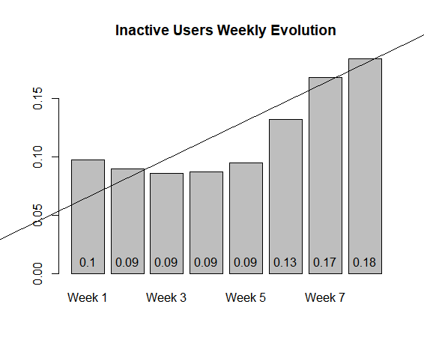
In order to respond 2nd question the graph below tries to depicts what happened with the mailing input.
First off, week1 corresponds to the 1st week of receiving mailing, so its 201903. Week 2, Week 3 and so forth
correspond to 201904, 201905 and so on.
Even though we have noticed that, indeed, the numbers of inactive users dropped due to the mailing effect, this ouput only lasts one week and then the number of inactive users goes up for the upcoming weeks. This can be seen in the graph below

Slide 17
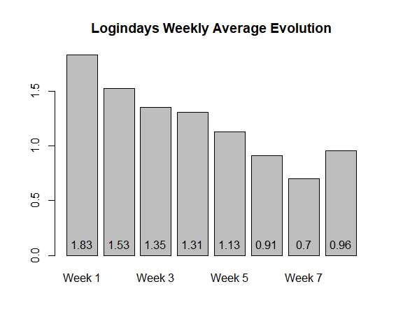
Worth to notice that the average (mean) logindays starts to decrease as long as we move onto upcoming weeks; around Week 5, the average login days started to decline, which contributes to the argument that the intervention effect last for 5 to 6 weeks

Slide 18
Conclusions
First off, given the results of the Prop Z Test, we can conclude that there are differences between the group of consistently inactive users that got the mail compared to the ones that did not.
However, given the second question, we can see that the effect of become more active in the game is not lasting that long for those that got the mail. We can see that in graphs : Inactive Users weekly evolution and Logindays weekly average evolution.
Third, I think is important to getting to know who are the consistently inactive users (regardless of the mailing). Other features like the weeksinceregistration can tell us more about how they behave (the old the member the less consistently inactive?) and the educationaclass (the ones that belong to classlevel 7 are more consistently inactive that the lower classes?)

Slide 19
Fourth, I may want to stress out that one marketing activity shouldnt has been thought as a solely single action that is going to has a lasting impact on a specific target.
We may want to explore if this mailing was more useful (engage longer) in other type of user (i.e inconsistently inactive?) so we don’t discard the strategy.
Lastly, we can arrange focus groups with consistently inactive users so they can tell us what aspects they did not find attractive in the game.

